Slide 1
PL/SQL Programming – L1

Slide 2
Course Objectives
Joins
PL/SQL Fundamentals
Exception Handling
Cursors
Procedures
Functions
Packages
Performance Tuning

Slide 3
Session Objectives
Triggers

Slide 4
Triggers

Slide 5
Triggers
Overview of Triggers
A Trigger:
  Is a named PL/SQL block associated with a table, view, schema or the database.
  Executes implicitly when an event takes place.
  Commonly used for auditing and business rule enforcement purposes.

Slide 6
Triggers Contd..
Guidelines for designing triggers
Design triggers to :
  Perform related actions.
  Centralize global operations.
Do not design triggers:
  Where functionality is already built into Oracle Server.
  That duplicate other triggers.
Use trigger only when necessary. Excessive use can result in complex interdependencies which may be difficult to maintain in large applications.

Slide 7
Triggers Contd..
Types of Triggers
Database Triggers
DML Triggers
Instead-Of Triggers
System Triggers

Slide 8
Triggers Contd..
DatabaseTriggers fall into three main categories: DML triggers, INSTEAD-OF triggers, and triggers on system and user events.
  DML Triggers fires when an INSERT, UPDATE, or DELETE statement is executed on a database table. They can be further classified as ROW or STATEMENT triggers. ROW and STATEMENT triggers specify how many times the trigger body should be executed.
  INSTEAD-OF Triggers fires when DML statements issued against a view.
  System Triggers fires during occurrence of system events such as database startup and shutdown, whenever a server error occurs. Fires also when DDL statements are executed.

Slide 9
Triggers Contd..
DML Triggers
A DML trigger is fired on an INSERT, UPDATE, or DELETE operation on a database table.
It can be fired either before or after the statement executes, and can be fired once per affected row, or once per statement.
DML Trigger components
Trigger Timing : When should the trigger fire ?
  Before :Execute the trigger body before the DML event occurs on a table.
  After :Execute the trigger body after the DML event occurs on a table.
Triggering Event : Which DML statement causes the trigger to execute
  INSERT
  UPDATE
  DELETE

Slide 10
Triggers Contd..
When the triggering event is an UPDATE statement, it is possible to include a column list to identify which columns must be changed to fire the trigger.
Example
Column list cannot be specified for an INSERT or DELETE statement, because they affect the entire row.
The triggering event can contain one,two or all of these three DML operations:
Example
Update of salary
…INSERT OR UPDATE OR DELETE…
…INSERT OR Update of salary…

Slide 11
Triggers Contd..
Triggering Type : Should the trigger body execute for each row the statement affects or only once.
  Statement :
  This is the default.The trigger body executes once for the triggering event.
  Fires once even when no rows are affected at all.
  Row:
  The trigger body executes once for each row affected by the triggering event.
  Does not execute if the triggering event affect no rows.
Triggering Body : What action should the trigger body perform ?
  Defines what needs to be done when the triggering event is issued.
  Can contain SQL,PL/SQL statements and can define PL/SQL constructs such as variables,cursors,exceptions and so on.

Slide 12
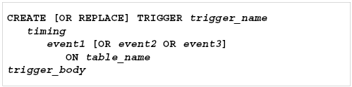
Triggers Contd..
Syntax for creating DML statement trigger
where,
trigger_name is the name of the trigger
timing – BEFORE or AFTER
triggering_event -event that fires the trigger (INSERT,UPDATE or
DELETE)
table_name is the table associated with the trigger.
trigger_body is the main code for the trigger.

Slide 13
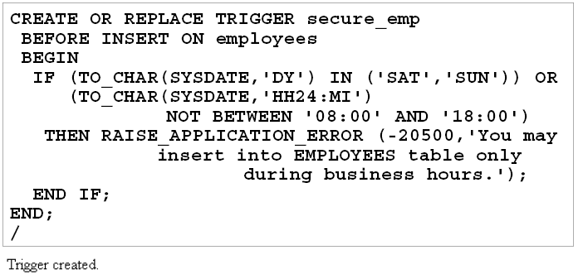
Triggers Contd..
  Example of a DML StatementTrigger
  The following trigger restricts Insert into EMPLOYEES table to certain business hours Monday to Friday.
  If an user attempts to insert a row into EMPLOYEES table on a Saturday,the user sees the message,the trigger fails and the triggering statement is automatically rolled back by the Oracle Server.

Slide 14
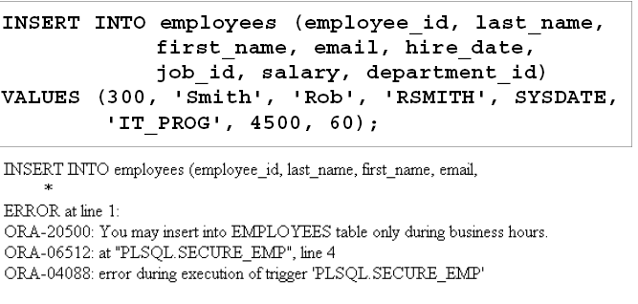
Triggers Contd..
Testing the trigger secure_emp
Insert a row into EMPLOYEES table using non business hours.When the date and time are out of the business timings specified in the trigger,error message is thrown.

Slide 15
Triggers Contd..
Trigger Predicates – INSERTING,UPDATING and DELETING
Several triggering events can be combined into one by taking into advantage of the trigger predicates – inserting, updating and deleting.
Predicate | Behavior
INSERTING | TRUE if the triggering statement is an INSERT; FALSE otherwise
UPDATING | TRUE if the triggering statement is an UPDATE; FALSE otherwise
DELETING | TRUE if the triggering statement is an DELETE; FALSE otherwise

Slide 16
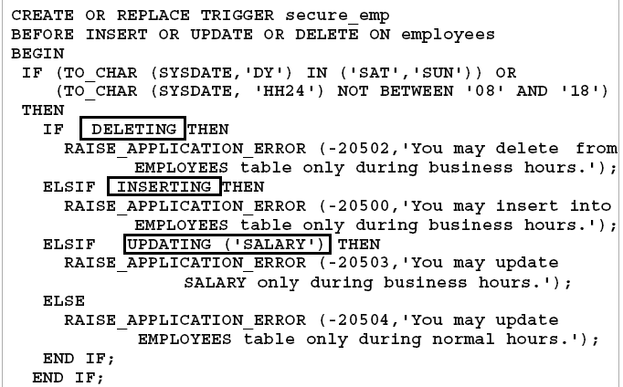
Triggers Contd..
Example

Slide 17
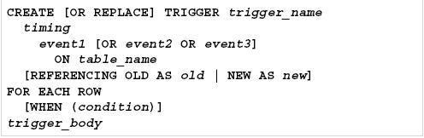
Triggers Contd..
Syntax for creating DML Row trigger
where
REFERENCING specifies the correlation names for the old and new values of the current row.
FOR EACH ROW indicates it’s a row trigger.
WHEN specifies the trigger restriction.
Other definitions are same as that of the DML statement trigger.

Slide 18
Triggers Contd..
  Example of a DML RowTrigger
  The following trigger on the EMPLOYEES table adds a row to the AUDIT_EMP_TABLE,logging the user’s activity against the EMPLOYEES table.
CREATE OR REPLACE TRIGGER audit_emp_values
AFTER INSERT OR UPDATE OF SALARY ON employees
FOR EACH ROW
WHEN (NEW.salary>15000)
BEGIN
INSERT INTO audit_emp_table (
user_name,timestamp,old_last_name,new _last_name, ld_title,new_title,old_salary,new_salary)
VALUES (
USER,SYSDATE,:OLD.employee_id,
:OLD.last_name, :NEW.last_name,
:OLD.job_id,:NEW.job_id,
:OLD.salary,:NEW.salary );
END;
/

Slide 19
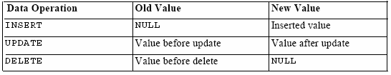
Triggers Contd..
The OLD and NEW qualifier can be used in a ROW trigger to reference the value of a column before and after data change.
The WHEN clause has been provided to restrict the trigger action to a certain condition.
Note :
The OLD and NEW qualifiers are available only in ROW triggers.
There is no colon prefix if the qualifiers are referenced in the WHEN clause.

Slide 20
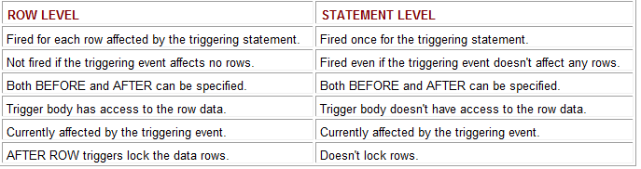
Triggers Contd..
Comparison between Row level and Statement level Triggers

Slide 21
Triggers Contd..
INSTEAD OF Triggers
An updatable view is one which can insert, update, or delete base table rows.
A view cannot be modified by normal DML statements if the view query contains SET operators, group functions, clauses such as GROUP BY, DISTINCT operator or joins.
So, INSTEAD OF triggers can be written that fires when an DML is issued against a view.
It performs the INSERT,DELETE and UPDATE operations directly on the underlying tables.

Slide 22
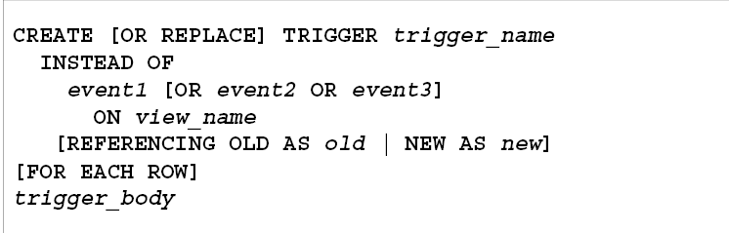
Triggers Contd..
Syntax for creating INSTEAD OF triggers
Where
trigger_name is the name of the trigger.
INSTEAD indicates the trigger belongs to a view.
event identifies the DML operation that causes the trigger to fire.
view_name indicates the view associated with the trigger.
REFERENCING specifies the correlation names for the old and new
values of the current row.

Slide 23
Triggers Contd..
FOR EACH ROW indicates it’s a row trigger.INSTEAD OF triggers can only be row triggers.
trigger_body specifies the action performed by the trigger.

Slide 24
Triggers Contd..
  Example of an INSTEAD OF Trigger
  Consider the following view based on the INSTRUCTOR and SECTION tables.
  This view is not updatable since it contains GROUP function COUNT();
  As a result, the following DELETE statement throws error :
CREATE VIEW instructor_summary AS
SELECT i.instructor_id,COUNT(s.section_id), total_courses
FROM instructor i,section s
WHERE i.instructor_id=s.section_id(+)
GROUP BY i.instructor_id;
DELETE FROM instructor_summary WHERE instructor_id=109;

Slide 25
Triggers Contd..
So, we need to create an INSTEAD OF trigger that performs the delete operation.
CREATE OR REPLACE instructor_trigger
INSTEAD OF DELETE ON instructor_summary
FOR EACH ROW
BEGIN
DELETE FROM SECTION WHERE instructor_id=109;
DELETE FROM INSTRUCTOR WHERE instructor_id=109;
END;

Slide 26
Triggers Contd..
System Triggers
A system trigger fires when a system event, such as database startup or shutdown, occurs, rather than on a DML operation on a table. A system trigger can also be fired on DDL operations, such as table creation.
Syntax for creating SYSTEM triggers
where
ddl_event_list is one or more DDL events (separated by the OR keyword), database_event_list is one or more database events (separated by the OR keyword).
CREATE [OR REPLACE] TRIGGER [schema.]trigger_name
{BEFORE | AFTER} {ddl_event_list | database_event_list} ON {DATABASE | [schema.]SCHEMA}
[when_clause] trigger_body;

Slide 27
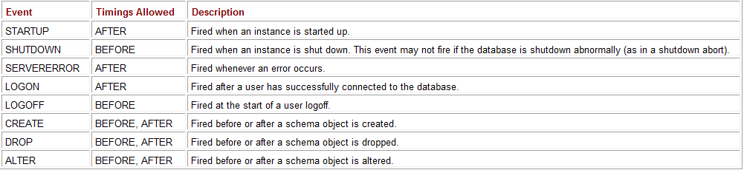
Triggers Contd..
System DDL and Database Events
Note :
There is no database event for TRUNCATE

Slide 28
Triggers Contd..
Example of a System Trigger
  Suppose we want to record whenever a data dictionary object is created. We can do this by creating a table as follows:
  Once this table is available, we can create a system trigger to record the relevant information.
  After every CREATE operation on the current schema, the logCreations trigger it records information about the object just created in ddl_creations.
CREATE TABLE ddl_creations (
user_id VARCHAR2(30),
object_type VARCHAR2(20),
object_name VARCHAR2(30),
object_owner VARCHAR2(30),
creation_date DATE);

Slide 29
Triggers Contd..
CREATE OR REPLACE TRIGGER LogCreations
AFTER CREATE ON SCHEMA
BEGIN
INSERT INTO ddl_creations (user_id, object_type, object_name, object_owner, creation_date)
VALUES
(USER, SYS.DICTIONARY_OBJ_TYPE, SYS.DICTIONARY_OBJ_NAME, SYS.DICTIONARY_OBJ_OWNER, SYSDATE);
END LogCreations;

Slide 30
Triggers Contd..
Managing Triggers
  Disable or reenable a database trigger :
  Disable or reenable all triggers for a table :
  Recompile a trigger for a table :

Slide 31
Triggers Contd..
Removing Triggers
To remove a trigger from the database, use the drop trigger syntax:
Syntax
Example
Note :
DROP TRIGGER trigger_name
DROP TRIGGER secure_emp;
When a table is dropped, all its associated triggers are also dropped.

Slide 32
Key Points to Remember
A trigger cannot exceed 32Kb in size. Statements like commit, rollback and savepoint cannot be used inside a trigger.
Multiple DML operations can be specified for the triggering event by separating them with the OR keyword. Conditional predicates are used to distinguish between INSERT ,UPDATE and DELETE operations and separate code is executed for each.
The NEW and OLD qualifiers must be prefixed with a colon (:) inside the trigger body. Even if custom names are used, they should still be referenced with the colon.
The REFERENCING clause can be used only for ROW- level triggers. If the REFERENCING clause is used in STATEMENT-level triggers, a compilation error occurs.
The WHEN clause is valid only for ROW level triggers. The colon (:) isn't used when referencing OLD and NEW in the WHEN clause.

Slide 33
Best Practices
Best Practice | Benefits
Even though Triggers exist in a separate namespace from database tables, procedures and functions.Give a unique name that does not conflict with that of these objects. | Avoids confusion between the names.Ensures that the function returns only once.
If the logic of the trigger is very lengthy, create stored procedures with the logic and invoke them in the trigger. | Reduces the lines of code and improves the understanding and debugging.

Slide 34


Slide 35
Thank You

